Slide 1
Qualification Manual

Slide 2
Index
Portal login page | p.3
Homepage | p.4
Qualification Process | p.9
a) Checking the Status of Category Qualifications | p.19
b) Verification of expiring or expired qualifications | p.21
c) Response to expression of interest in qualification renewal | p.24
d) Update of Category Questionnaires: Request for Revision of Category Questionnaires | p.26
e) Update of general questionnaires | p.30
f) Application for qualification on new categories | p.34
(g) Expiring or expired category documents | p.38
To access the different sections, click on the table of contents.

Slide 3

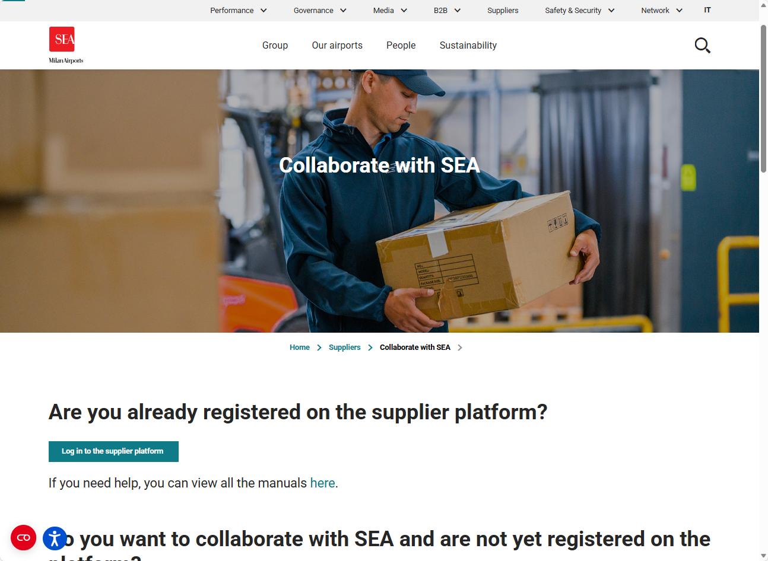
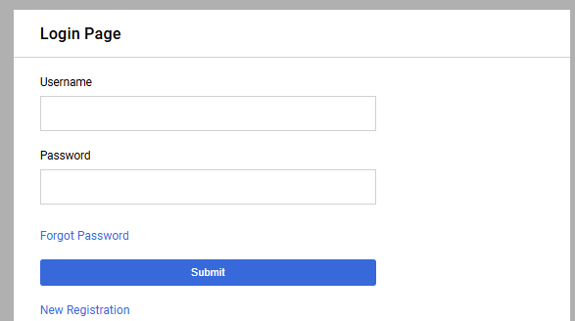
Login
You can reach the portal via the following URL: Collaborate with SEA | SEA Corporate
To log in, enter your credentials and click 'Submit'.

Slide 4
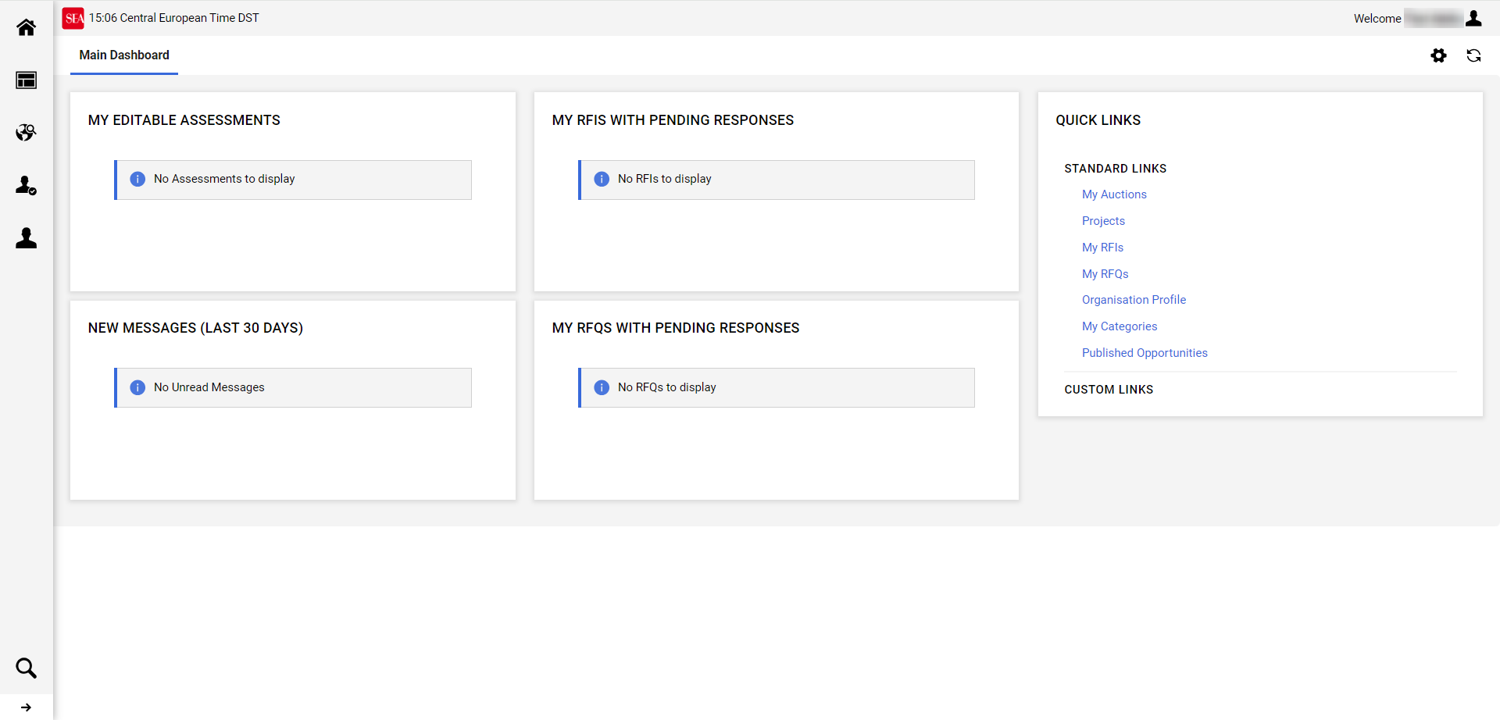


Home Page- Suppliers Portal
After logging in, the user is directed to the main portal screen, which displays a list of all the activities assigned and visible to the user.
The central part of the screen, Main Dashboard, consists of thematic sections called 'Widgets' containing quick links to the different parts of the portal (1).
In the sidebar, are available various icons, that allow the user to navigate to different areas of the application (2).

Slide 5
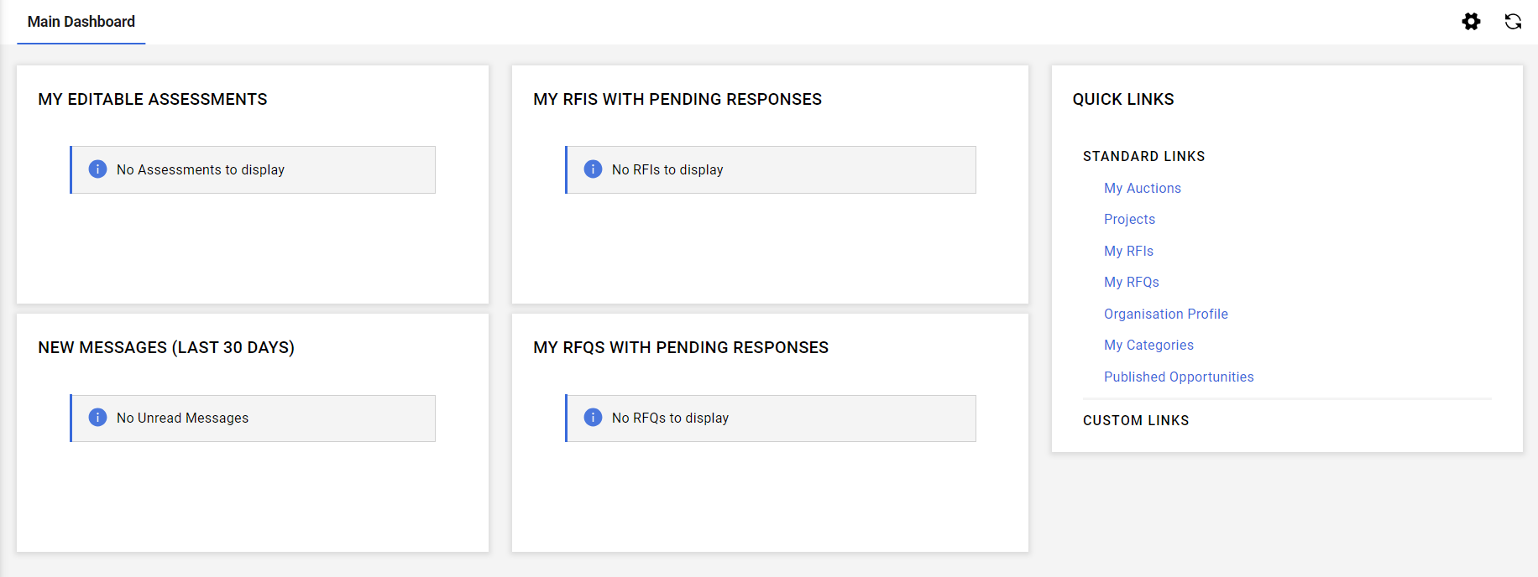
Home Page- Suppliers Portal
"Qualification Requests in Progress" shows the questionnaires requested by Sea and represents a list of tasks to be completed.
"Quick Access" , offers a set of quick links, allowing users to access specific pages of the platform with just one click.
"RdI pending response"
list of requests awaiting a reply
"New Messages " list of unread messages received within the last 30 days
"Pending RoO"
List of offer requests awaiting a reply.

Slide 6




Home Page- Suppliers Portal
Clicking the icon on the main screen updates the homepage, while clicking on any other page redirects you back to the homepage.
Allows access to the editing section of the main screen.
It allows access to the area of Tender Notices, RoO, RoI and Auctions.
It allows access to the company profile, evaluation and category area.
Allows access to the user management and setting area.

Slide 7
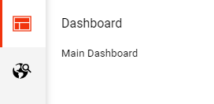
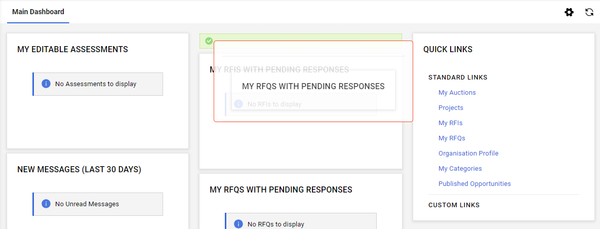
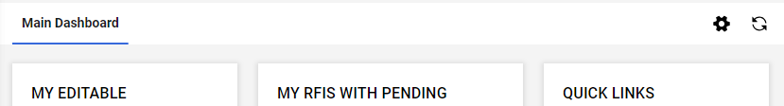

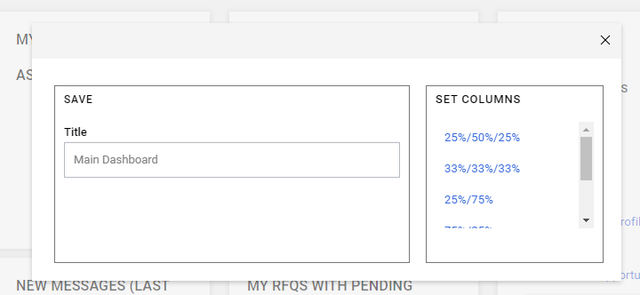

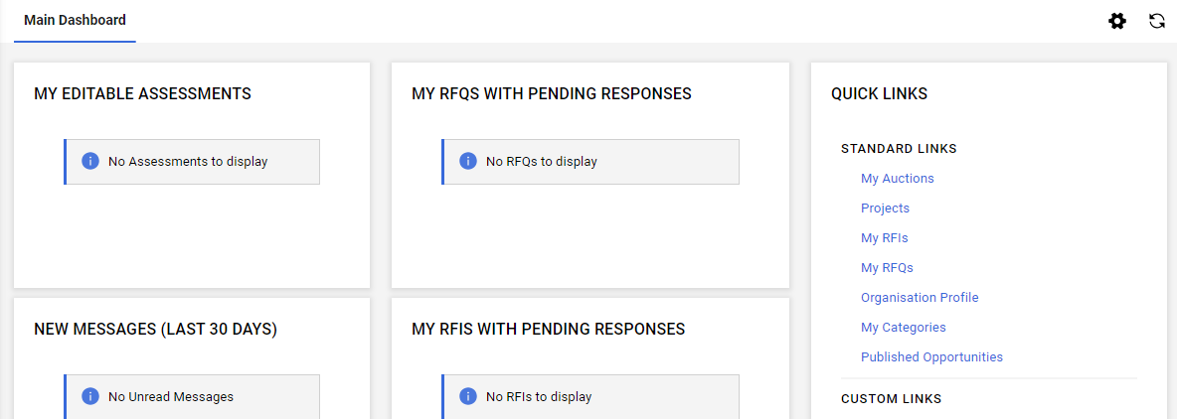
Home Page- Suppliers Portal
The Dashboard section (2) allows the user to customize the main screen.
Below are the steps for customizing and ordering the ‘Main Dashboard’ :
Navigate to 'Configuration’ (2).
Click on the settings icon located at the top right(1);
Continue with the modifications:
  Set the size of the widgets and close the screen by clicking on the ‘x’ (3) ;
To reorder the widgets: hover over the widget title and drag the widget rectangle to the desired position.

Slide 8

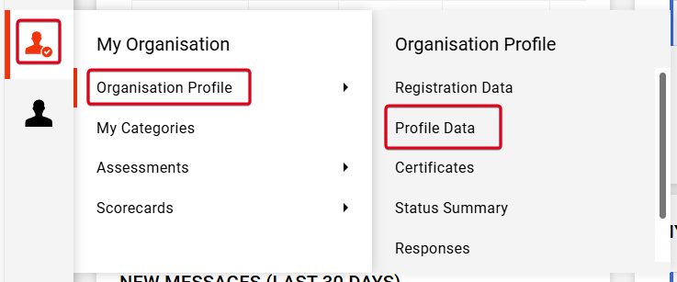

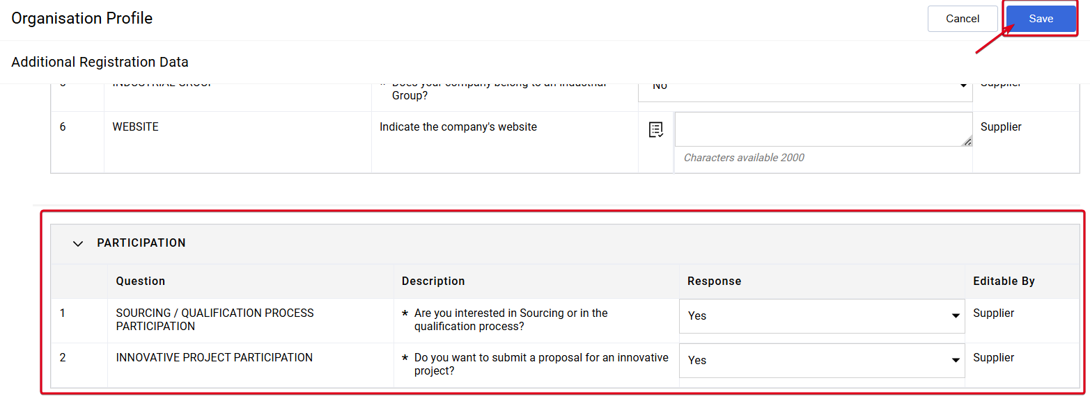
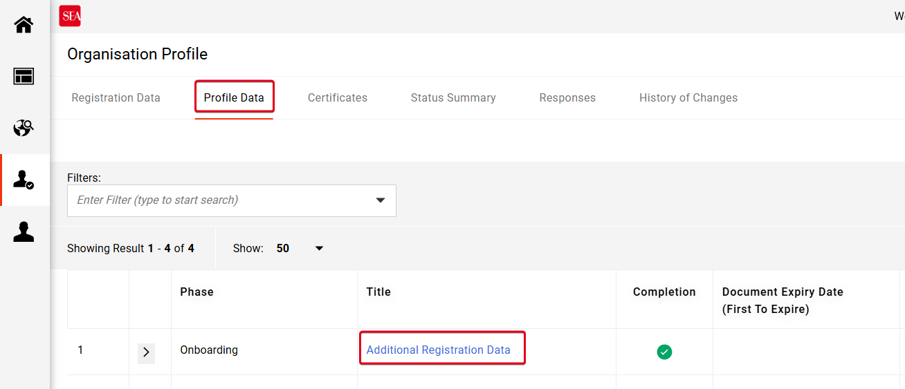



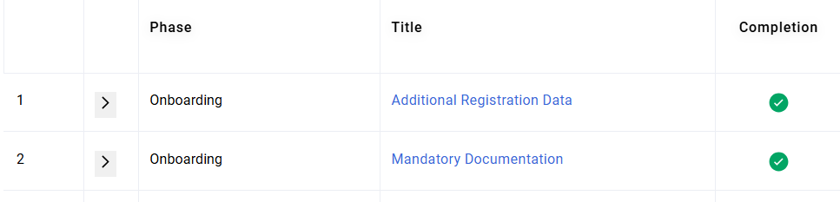
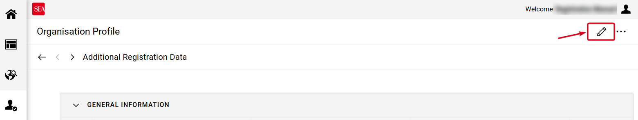


Qualification Procedure – Application for Sourcing/Qualification partecipation
If not indicated during the initial registration phase, the authorized user can express their preference to participate in competitions/Albo qualification even later.
Access the Profile: Navigate to Organisation Profile > Profile Data (1).
Modify Participation: Enter “Additional Registration Data” (2) and use the pencil icon (3) to edit the participation responses.
Save Changes: Select "Yes" (4) for the request SOURCING / QUALIFICATION PROCESS PARTICIPATION and click on «Save» (5).
The "Mandatory Documentation" section will appear in the profile.

Slide 9

Qualification Process
The steps required to qualify in a category:
The steps required to renew qualification in a category:
New category selection
Completion of the general questionnaire
Completion of the specific questionnaire for the chosen category
Sending the renewal request
Response to expression of interest in qualification renewal
Update of the general questionnaire
Updating the category questionnaire

Slide 10
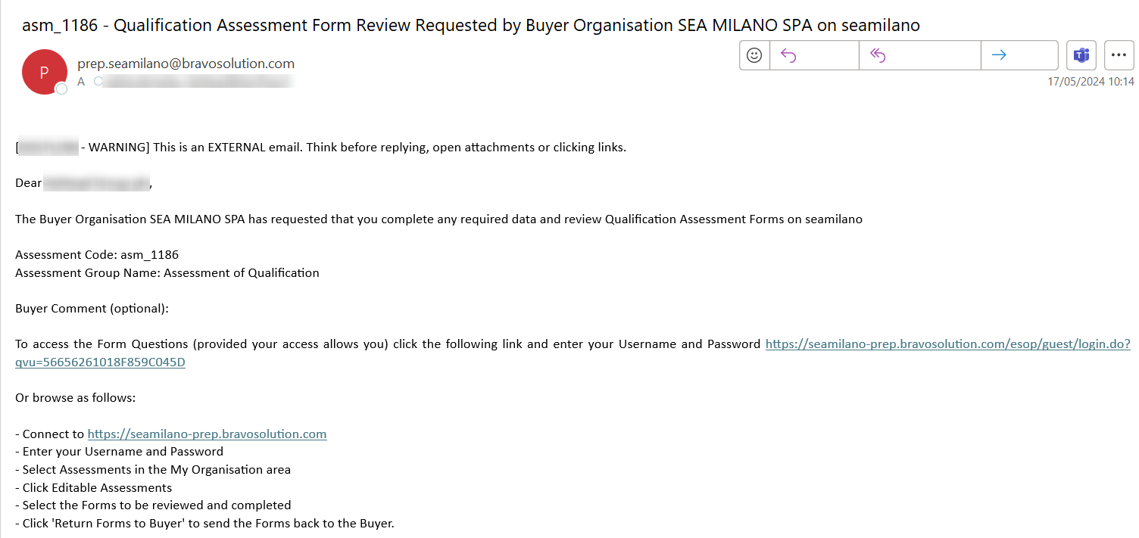
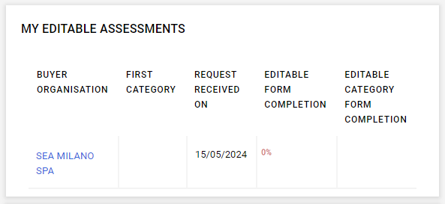
General Questionnaire
Immediately after being enabled to the platform, a request is generated to fill out the General Questionnaire, which is necessary for the completion of the qualification process.
here are two methods to access the questionnaire:
Using the link received in the notification e-mail (1).
Navigating to the 'Ongoing Qualification Requests' section on the homepage, then clicking on the name of the evaluating company (highlighted in blue) (2).
To identify whether the request pertains to the General Questionnaire, it's important to verify that only the following three fields are completed: ‘Buyer organization’, 'Request received on', and ‘Editable form completion'.

Slide 11
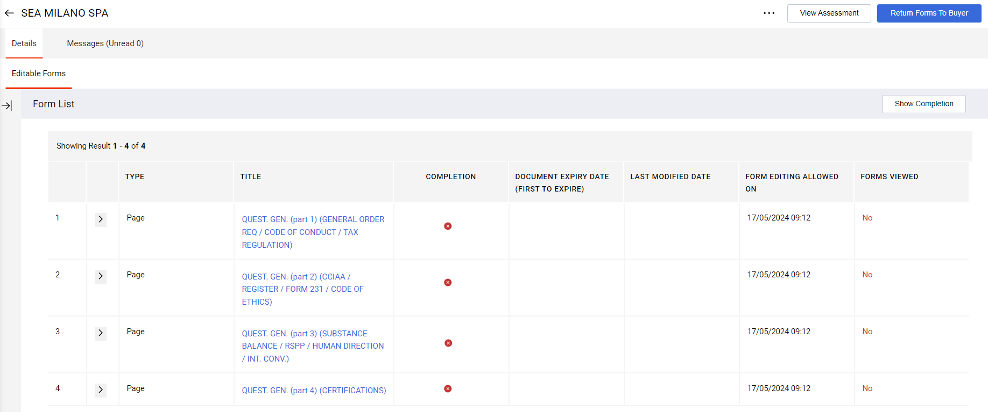
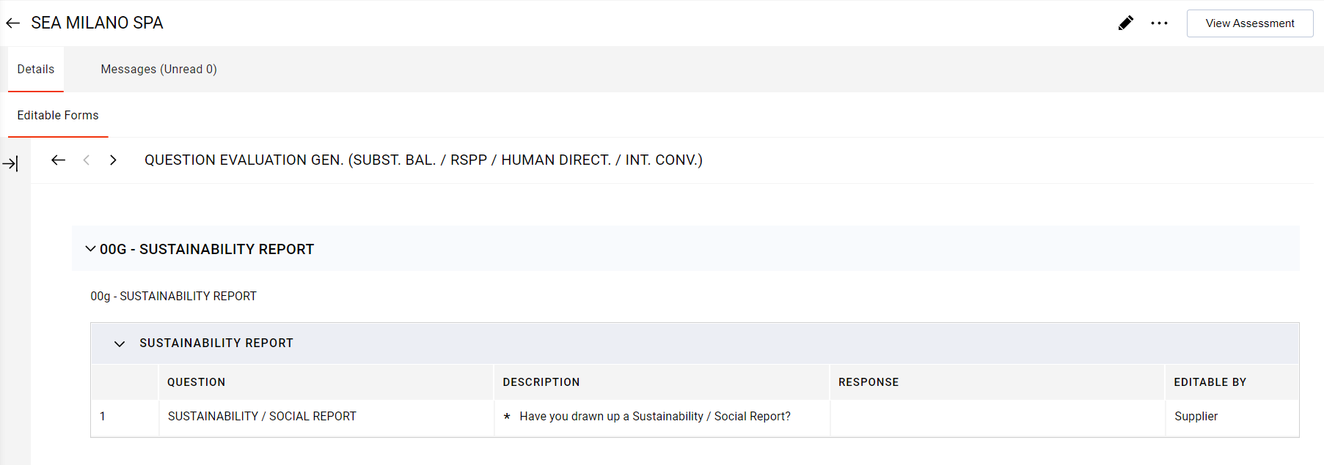
General Questionnaire
The ‘General Questionnaire’ detail page displays the general questionnaire to be completed.
Follow the steps below to answer the questionnaire:
Click on the name of the questionnaire (1)
Then, click on the pencil icon, which will open the editing mask (2).

Slide 12
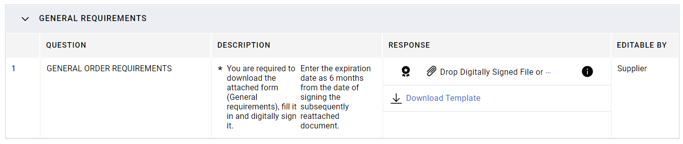
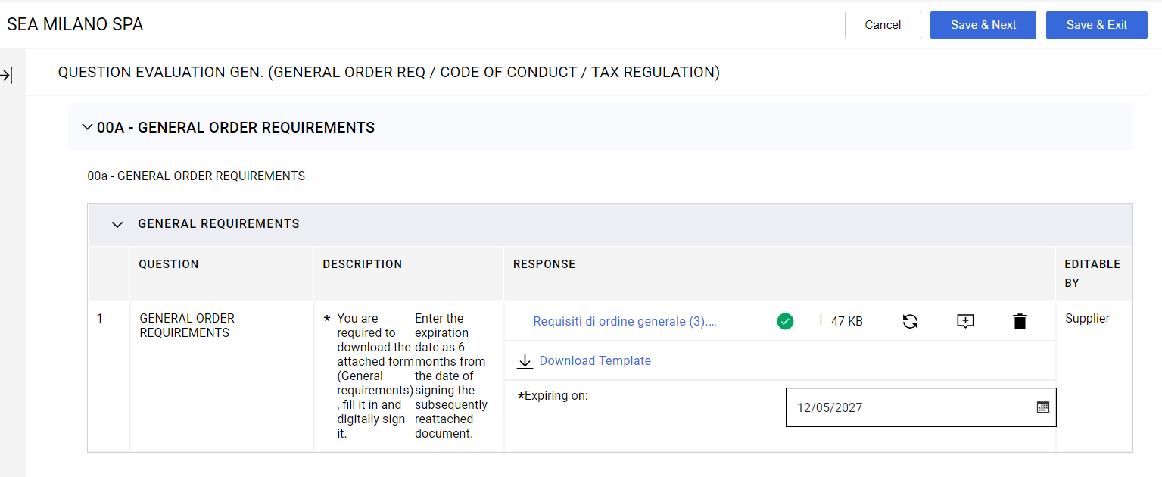
General Questionnaire
Continue with filling out the questionnaire:
  Some questions require attaching a document and specifying the expiration date in the relevant fields: click on the paperclip icon (1) to add the document.
To save the compilation, select 'Save and Exit (3)'.
The user can continue to update the document via the icons to the right of the attached file (2):
Replace the attached file
Add a comment
Delete the attached file

Slide 13
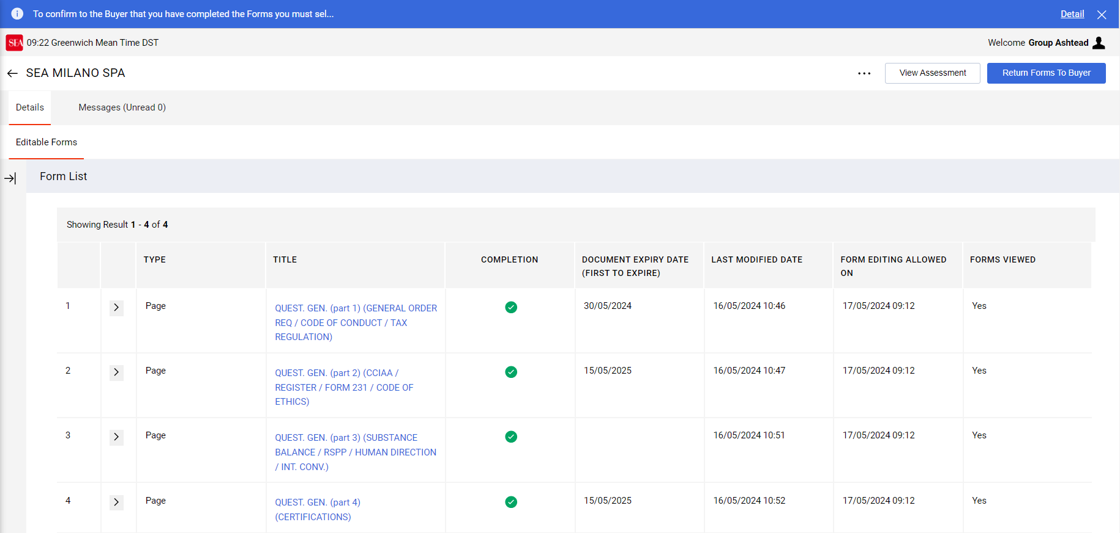
General Questionnaire
Once you have completed all questionnaires, select ‘Return Forms To Buyer’ to send your answers to Sea (1).
Note: Once questionnaires have been submitted, they will no longer be visible. To update the questionnaires, you will need to make a request. (see slide 'e) updating general questionnaires').

Slide 14


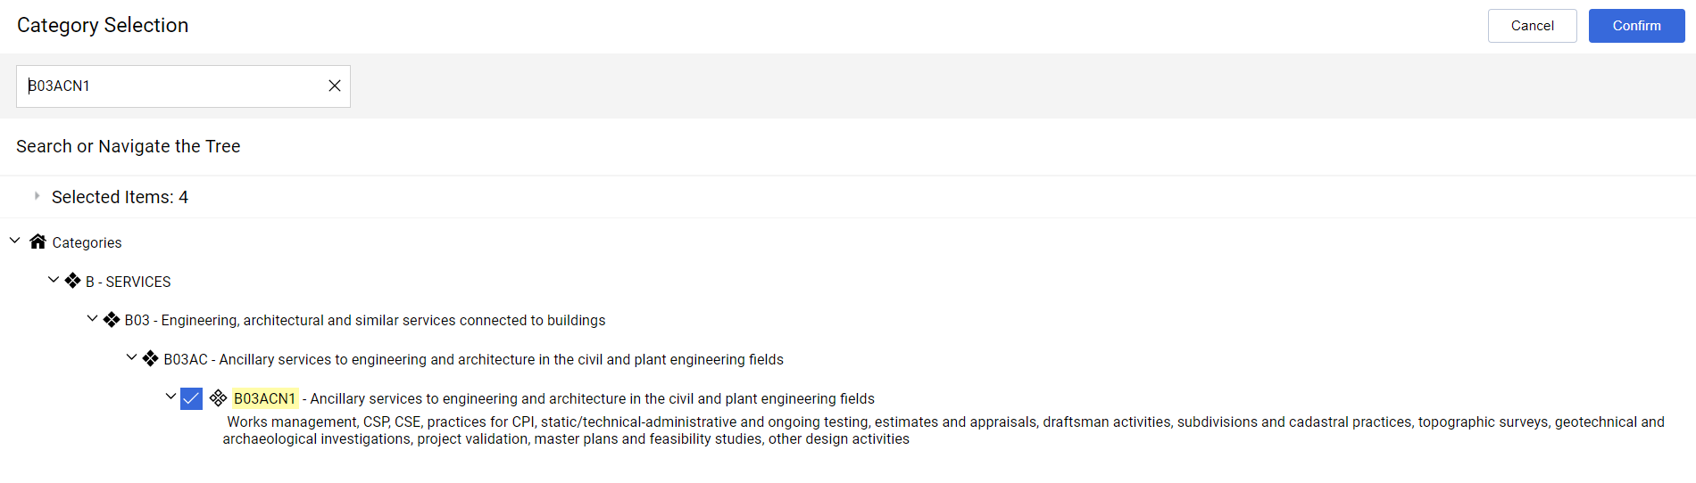
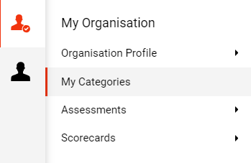

Submission for category qualification
How to apply for a Category:
Select the Icon « »in the sidebar. In the opened menu, select "My Categories"(1).
On the right side of the screen, click on the "Add category" button (2).
From the list of available categories, select the desired category (3).
Click on the 'Confirm' button (4) to complete the application process.

Slide 15
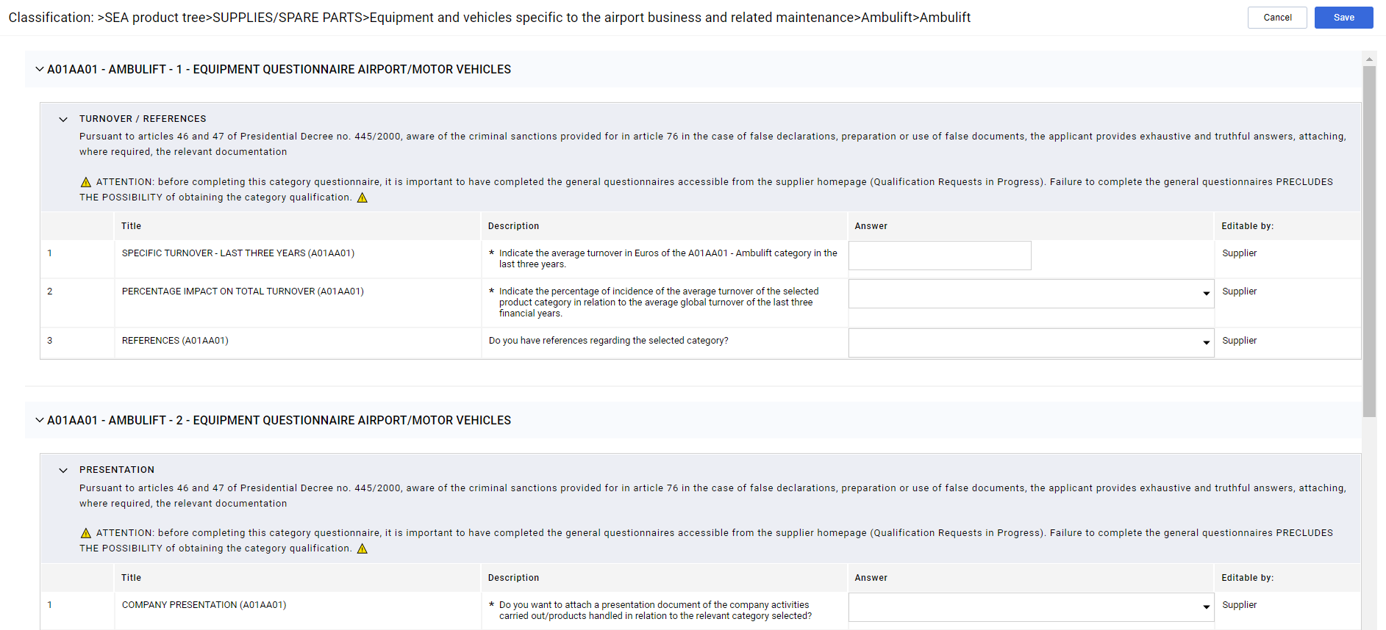
Submission for category qualification
Answer the category questionnaire. (Note: In all sections of the questionnaire there is a cross-reference for filling in the general questionnaire in order to obtain the category qualification).
Click on 'Save' to save your answers (2).

Slide 16

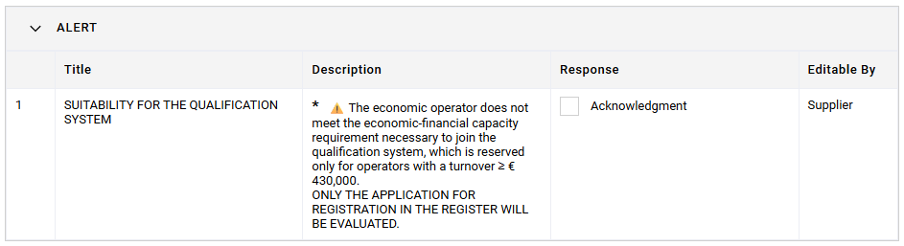
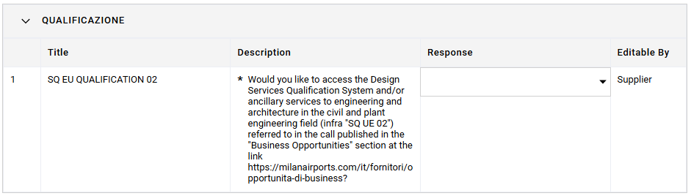
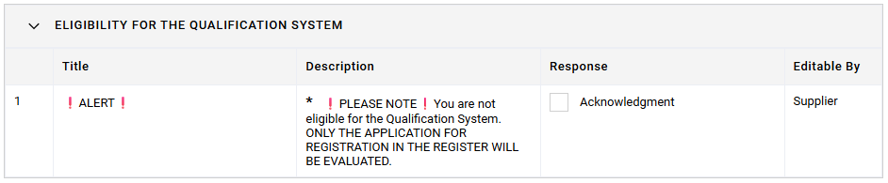
Submission for category qualification – Qualification process (if applicable)
For specific categories, the questionnaire assesses the eligibility for the Qualification System (QS).
Two automatic scenarios:
CASE A: NOT ELIGIBLE for the Qualification System
You are informed that you do not meet the requirements for the qualification system, but you can still proceed with the standard registration to the Supplier Register.
To continue, please check the «Acknowledgment» box to confirm that you have read the outcome.
CASE B:SQ EU Qualification 02, Choice of Participation (Yes/No)
Once eligibility is confirmed, you are required to specify your intention to participate or not participate in the Qualification System for that category. The selection is necessary to complete the procedure.
If you choose to join, you will access the Qualification System questionnaires, which consist of a series of specific requirements.
If these questionnaires reveal that the requirements are not met, you will be informed that you are not eligible for the Qualification System and ONLY THE REGISTRATION APPLICATION TO THE REGISTER WILL BE EVALUATED.
At this point, click on the "Acknowledgment" field to confirm that you have read the information and to proceed.

Slide 17
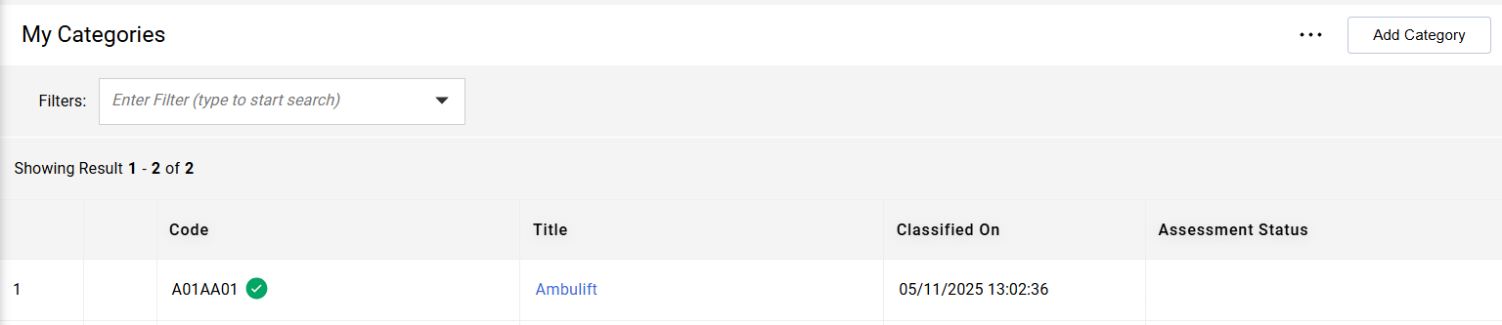
Submission for category qualification
The category will now be visible in the "My Categories" section, where you can also view its details and modify the responses if necessary.
​
Once all the responses have been provided, the icon next to the category “Code” will turn green and the status will then change to 'Under Review'.
At that point, the qualification will be created, and the applications will enter the review phase to verify their compliance.

Slide 18
Qualification Process
The supplier involved in a qualification process may proceed as follows :
Checking the Status of Category Qualifications: check the status of their current qualifications via the platform
Verification of expiring or expired qualifications
Response to expression of interest in qualification renewal
Updating of category questionnaires: replacement and/or updating of expiry dates of certificates and answers to questionnaires
Update of general questionnaires: replacement and/or updating of expiry dates of certificates and answers to questionnaires
Application for qualification on new categories: apply for new qualifications
Expiring or expired category documents

Slide 19

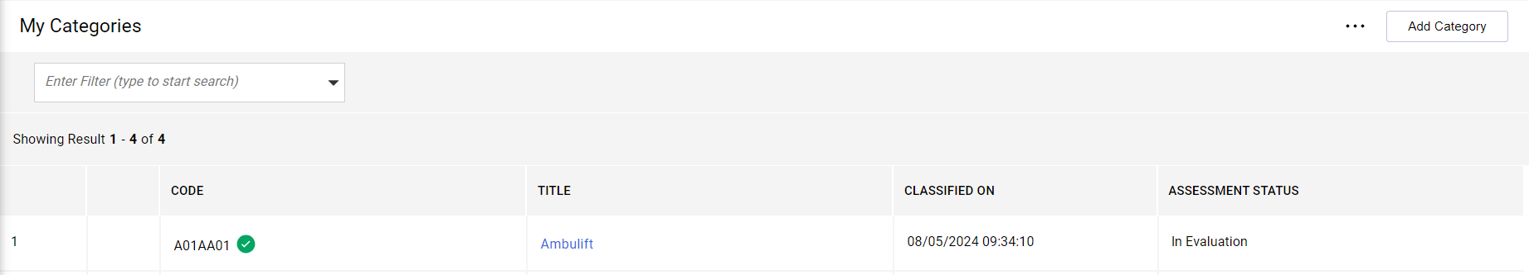
Checking the Status of Category Qualifications
How can I check the status of the category:
Select the a icon in the sidebar ‘ '.
In the opened menu, select 'My Categories' (1).
In the 'My Categories' screen displayed, you can find the current status of the categories in the ‘Assessment Status' field (2).

Slide 20
Checking the Status of Category Qualifications
What are the possible statuses attributed to the category :
Assessment status not visible: The questionnaires have not yet been filled in or the qualification has not yet been created.
In Evaluation: The qualification has been created, and the application is currently being evaluated, where the answers given in the questionnaires are checked for compliance.
Qualified: You are qualified for the category for which you are applying.
Not Qualified: You are not qualified for the category.
Expired: The qualification has expired.

Slide 21
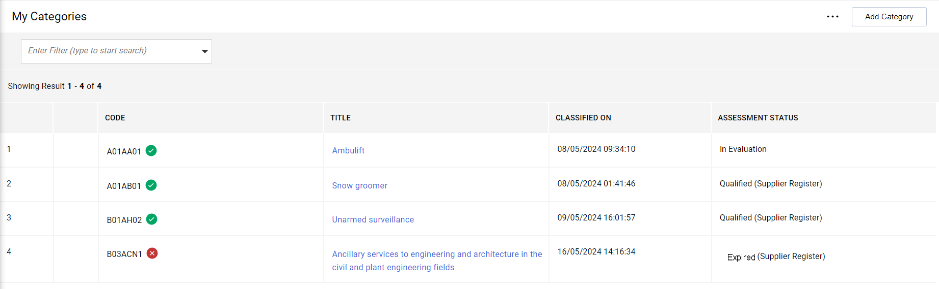
Verification of expiring or expired qualifications
How to identify expiring or expired qualifications:
Access the 'My Categories' section: Select the Icon in the sidebar ‘ ' and click on 'My Categories' (1).
In the 'Valuation Status' box, the category is indicated as 'Expired(...)'.

Slide 22
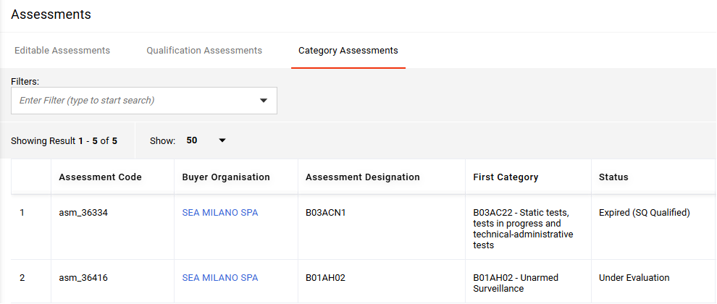
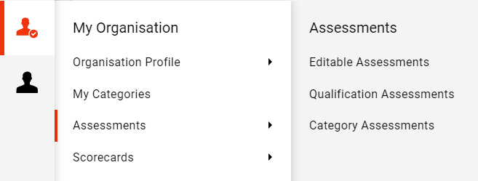
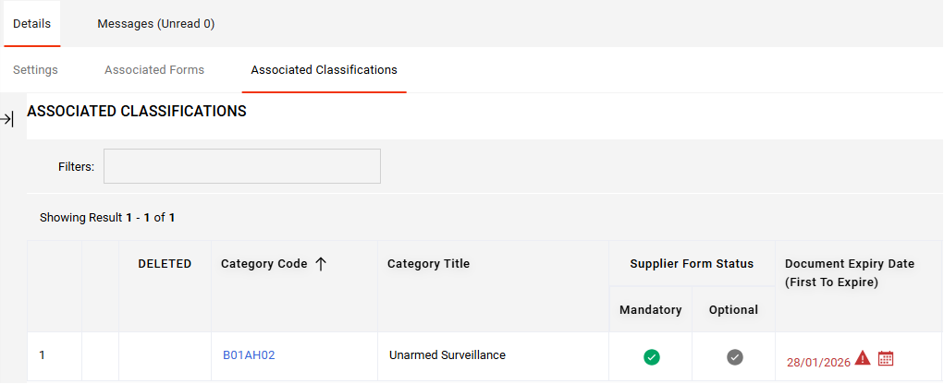

Verification of expiring or expired qualifications
What to do when the qualification is expiring or expired:
Inform Sea that you wish to renew your qualification:
  Access the "Category Assessments" section: Select the Icon in the sidebar « » and click on «Assessments" and then on "Category Assessments" (1).
  Locate and select the expired or expiring qualification (2) to access its detail section (3).

Slide 23
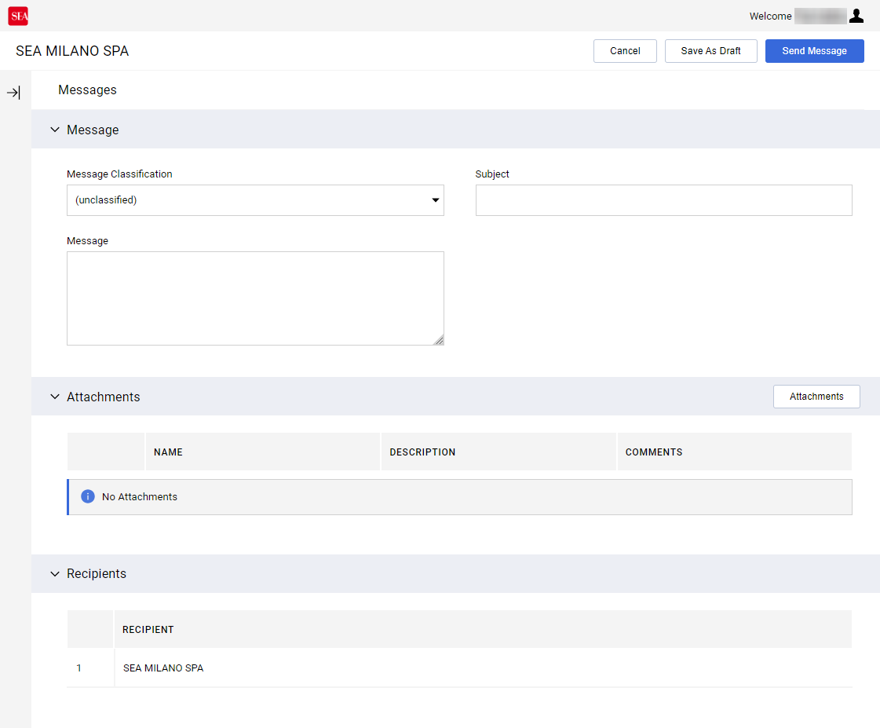

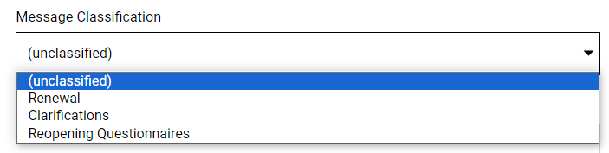
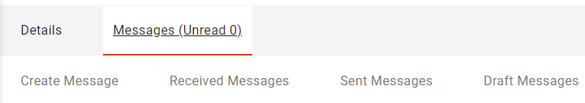
Verification of expiring or expired qualifications
Select 'Messages (Unread...)' and then 'Create Message' (1);
Proceed with the compilation of the message:
  Indicates "Renewal" or "Reopening Questionnaires" for the "Message Classification" field;
  Indicate the subject and message, if necessary you can attach a document by clicking on the 'Attachments' button;
Select 'Send Message' in the top right-hand corner to proceed with sending.
The sent message will be visible in the 'Sent Messages' section

Slide 24
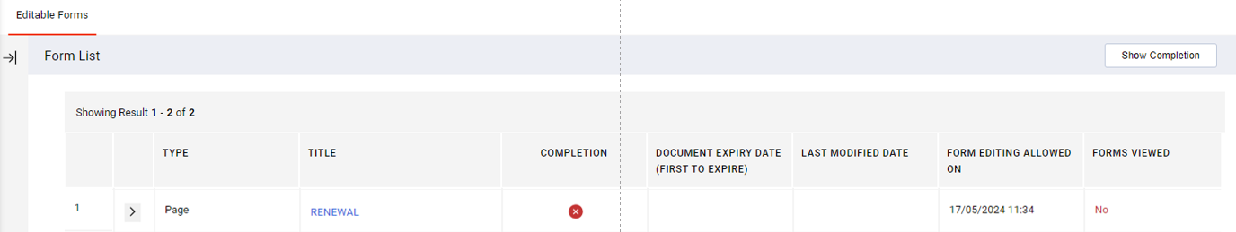
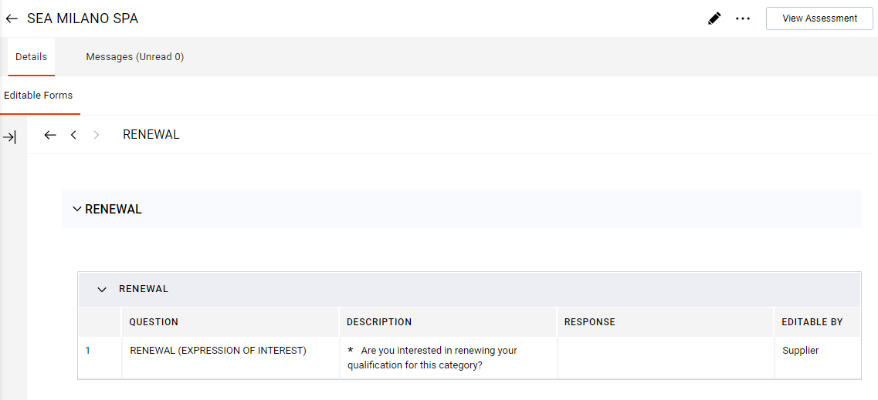
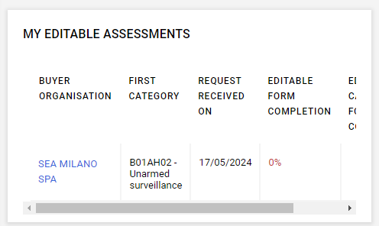

Response to expression of interest in qualification renewal
After sending the renewal request, Sea sends a confirmation form.
How to reply to the 'Renewal (Expression of Interest)' form:
Access the renewal form: select the required form (1) in the ‘My Editable Assessments’ box on the homepage.
When the form opens, select the form (2) to access the details (3).

Slide 25
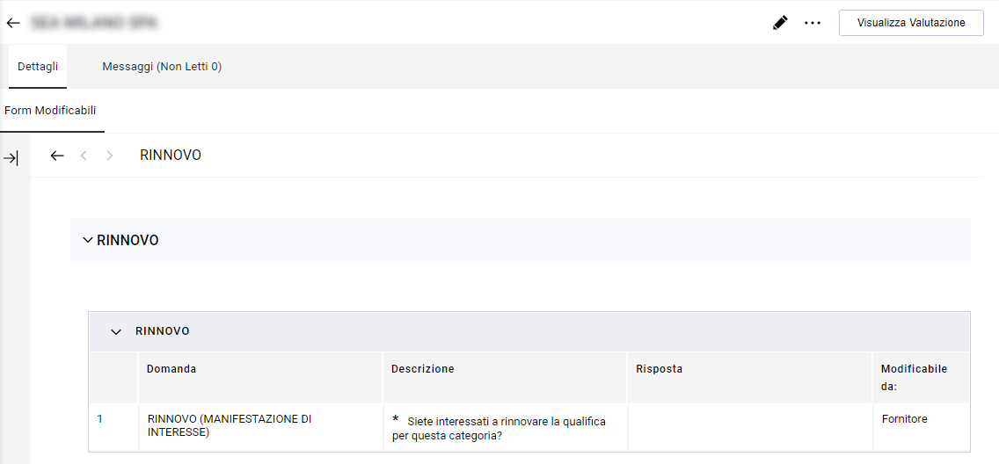
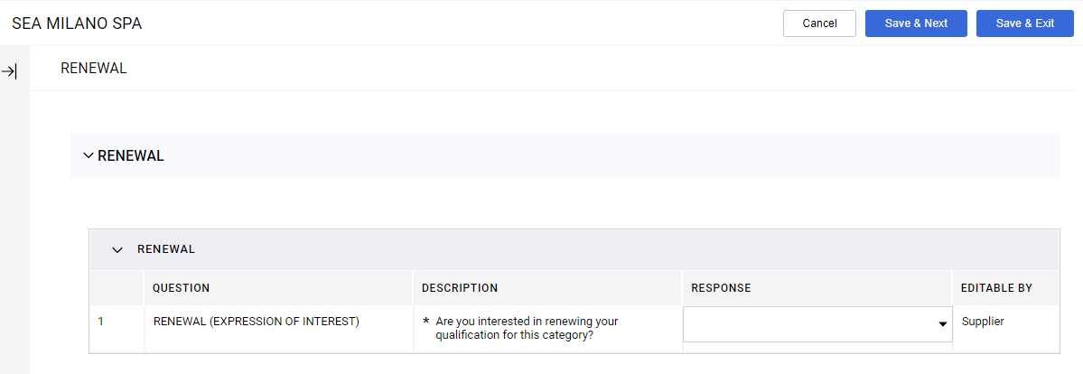
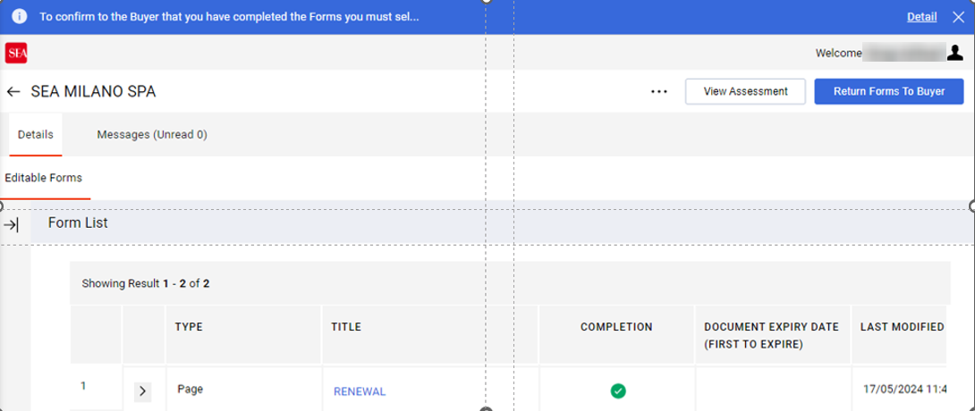

Response to expression of interest in qualification renewal
Select the pencil in the top right-hand corner (1) and proceed to the answer (2).
Click on the 'Save & Exit' button in the top right-hand corner (3).
Finally, click on the «Return Forms To Buyer» button to confirm to Sea that you have responded(4).

Slide 26
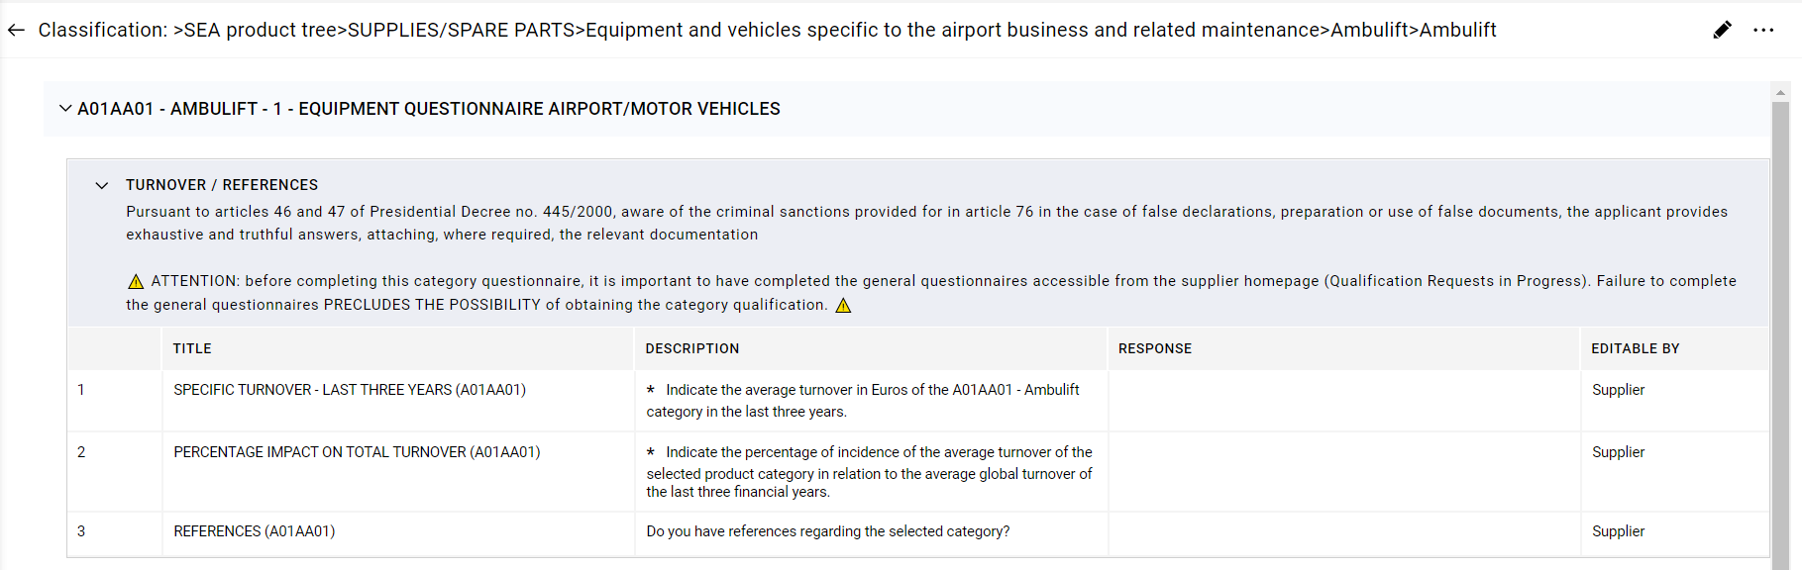
Updating of category questionnaires
How to proceed to update the category questionnaires:
Access the "My Categories" section Select the Icon in the sidebar and click on 'My Categories' (1).
Choose the category for which you wish to complete or modify the questionnaire (2) .
Once the category has been selected, access the corresponding detail area (3).
NB. REMEMBER to have first filled in and submitted the General Questionnaire available in the appropriate link in the 'Ongoing Qualification Requests' dashboard

Slide 27



Updating of category questionnaires
Click on the pencil icon in the top right-hand corner, to access the questionnaire editing mask (1).
After making the desired changes, click on the 'Save' button in the top right-hand corner (2).
NB. REMEMBER to have first filled in and submitted the General Questionnaire, available through the link in the 'Ongoing Qualification Requests' dashboard
Nb. When the new classification is displayed with the icon « » , it indicates that the mandatory questions of the questionnaire have not been completed. Once these questions are answered, the classification will appear with the icon « », indicating their completion.

Slide 28
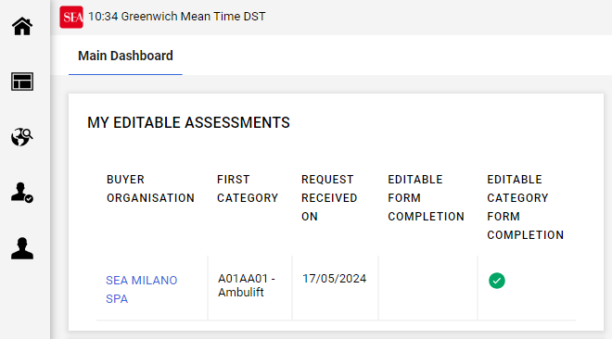
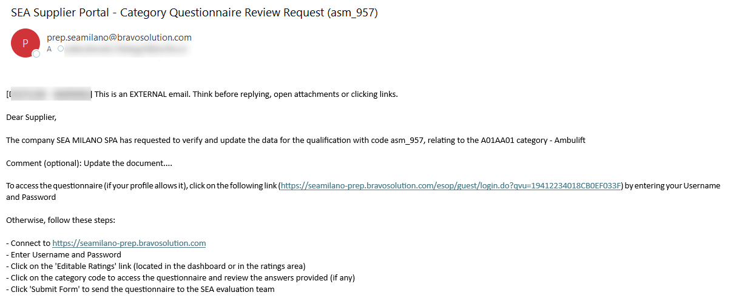
Update of Category Questionnaires: Request for Revision of Category Questionnaires
How to Respond to a Request to Review Category Questionnaires:
Access the questionnaire in question:
  Quick Access from the Mail: Click on the link provided in the mail to be directed directly to the questionnaire (1).
  Portal Access: On the portal homepage, go to the 'Current Qualification Requests' box and select the category (2).
To identify whether the request is related to the category questionnaire, check whether the field 'First Category' is filled in

Slide 29
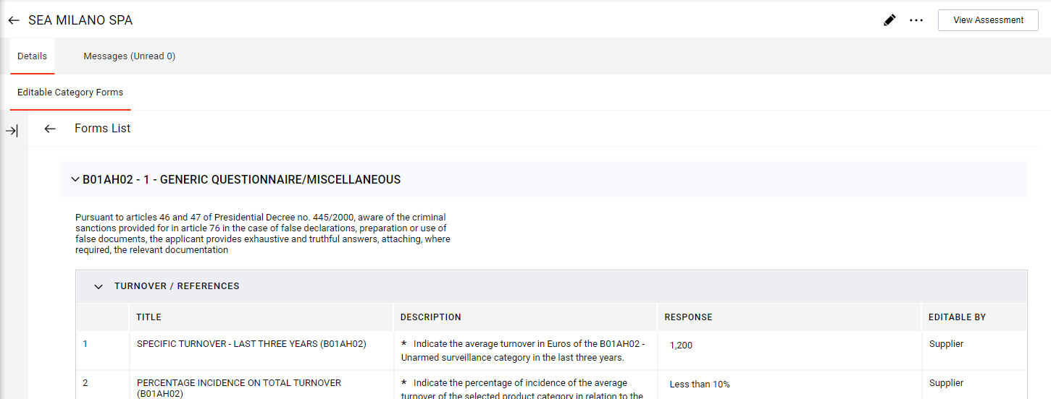
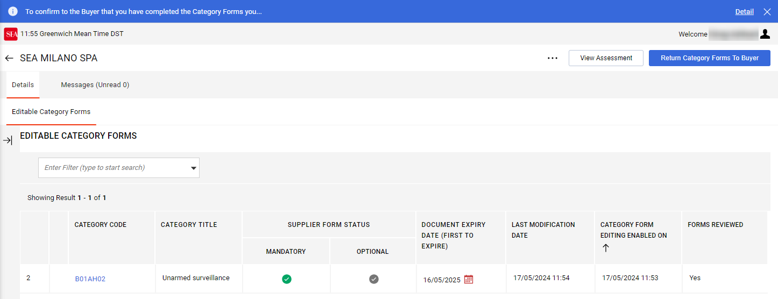

Update of Category Questionnaires: Request for Revision of Category Questionnaires
Once within the category:
Select the pencil icon to open the editing mask (1).
Make the required changes and press the 'Save' button to save the changes (2).
Finally, click on the ‘Return Category Form to Buyer' button to confirm the changes to the category form (3).
Notes:
After logging into the category for which the change was requested, follow the steps below:
Open the Category in question
Select pencil to make changes
Select the 'Save' button to save changes
In conclusion, click 'Submit Category Form to Assessor' to confirm that you have made the required changes to the category form

Slide 30
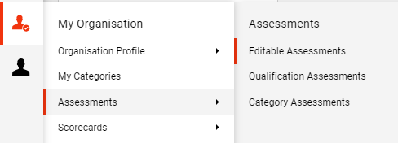
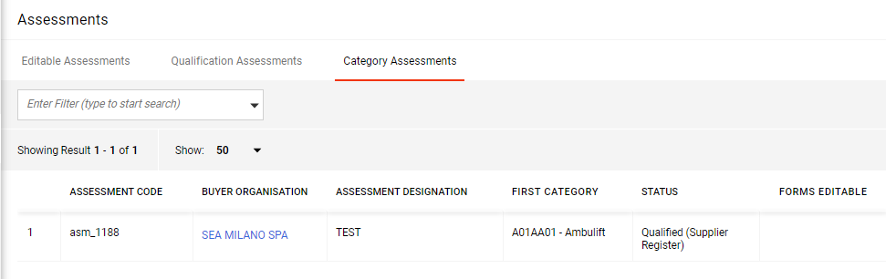
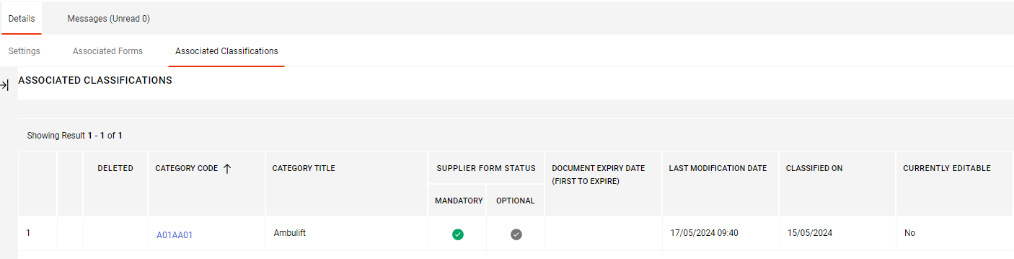
Update of general questionnaires
What to do in order to update the documents in the general questionnaire:
As the general questionnaire is linked to the individual category, it is necessary to inform Sea that you want to renew your qualification:
  Access the "Category Assessments" section: Select the Icon in the sidebar « » and click on «Assessments» and then on "Category Assessments" (1).
  Locate and select a category qualification (2) to access its detail section (3).

Slide 31

Update of general questionnaires
Select 'Messages (Unread...)' and then 'Create Message' (1).
Proceed with the compilation of the message:
  Indicates "Renewal" or "Reopening Questionnaires" for the "Message Classification" field;
  Indicate the subject and message, if necessary you can attach a document by clicking on the 'Attachments' button;
Select 'Send Message' in the top right-hand corner to proceed with sending.
The sent message will be visible in the 'Sent Messages' section
In conclusion, wait for the General Questionnaire Review request.

Slide 32


Update of General Questionnaires: Request for Revision of General Questionnaires
How to respond to a request to review general questionnaires:
Access the questionnaire in question:
  Quick Access from the Mail: Click on the link provided in the mail to be directed directly to the questionnaire (1).
  Access via Portal: On the portal homepage, go to the ‘My editable assessments’ box and select the evaluating company (2).

Slide 33



Update of General Questionnaires: Request for Revision of General Questionnaires
Once within the category:
Select the questionnaire (1) and then the pencil icon to open the editing mask (1).
Make the required changes and press the 'Save and Exit' button to save the changes (2).
Finally, click on the ‘Return Forms To Buyer' button to send the updated questionnaire to Sea (3).
Notes:
After logging into the category for which the change was requested, follow the steps below:
Open the Category in question
Select the pencil to make changes
Select the 'Save' button to save changes
In conclusion, click 'Submit Category Form to Assessor' to confirm that you have made the required changes to the category form

Slide 34



Application for qualification on new categories
Even if you already have a current category qualification, you can apply for other existing qualifications :
Access the 'My Categories' section: Select the icon in the sidebar ( ) and click on 'My Categories’;
Select 'Add Category', top right (1);
In the selection mask, you will find the 'Selected Items' section, where all the product categories you have applied for in the past are listed (2);
From the list of available categories, select the desired new category (3);
Click on the 'Confirm' button in the top right-hand corner, to complete the application process (4).
Notes:
After logging into the category for which the change was requested, follow the steps below:
Open the Category in question
Select the pencil to make changes
Select the 'Save' button to save changes
In conclusion, click 'Submit Category Form to Assessor' to confirm that you have made the required changes to the category form

Slide 35

Application for qualification on new categories
Continue with the completion of the Questionnaire: The questionnaire to be completed will open (1). In the event of a classification after the first one, the general questionnaire will be updated with the new category .
Click the 'Save' button at the top right to save your answers (2).
Notes:
After logging into the category for which the change was requested, follow the steps below:
Open the Category in question
Select pencil to make changes
Select the 'Save' button to save changes
In conclusion, click 'Submit Category Form to Assessor' to confirm that you have made the required changes to the category form

Slide 36
Application for qualification on new categories - Qualification Systems (if applicable)
For specific categories, the questionnaire assesses the eligibility for the Qualification System (QS).
Two automatic scenarios:
CASE A: NOT ELIGIBLE for the Qualification System
You are informed that you do not meet the requirements for the qualification system, but you can still proceed with the standard registration to the Supplier Register.
To continue, please check the «Acknowledgment» box to confirm that you have read the outcome.
CASE B:SQ EU Qualification 02, Choice of Participation (Yes/No)
Once eligibility is confirmed, you are required to specify your intention to participate or not participate in the Qualification System for that category. The selection is necessary to complete the procedure.
If you choose to join, you will access the Qualification System questionnaires, which consist of a series of specific requirements.
If these questionnaires reveal that the requirements are not met, you will be informed that you are not eligible for the Qualification System and ONLY THE REGISTRATION APPLICATION TO THE REGISTER WILL BE EVALUATED.
At this point, click on the "Acknowledgment" field to confirm that you have read the information and to proceed.

Slide 37

Application for qualification on new categories
The category will now be visible in the "My Categories" section, where you can also view its details and edit the responses if necessary.
​
Once all the responses have been provided, the icon next to the Category Code will turn green, and the status will subsequently change to 'Evaluation'.
At that point, the qualification will be created, and the applications will enter the review phase to verify their compliance.

Slide 38


Expiring or expired category documents
How to proceed when documents are about to expire or have expired:
Check the content of the e-mail to identify the documents concerned and the expiry date indicated.
In the 'My Categories' section, select the category identified with the expired documents, and access the category details (1). Here you will be able to locate expired documents marked '*Expiired on:[dd/mm/year]' (2).

Slide 39



Expiring or expired category documents
What happens when the documents of a specific category are about to expire or have expired:
When a category document is nearing expiry, you will receive an email notification with detailed instructions on how to proceed.
You can identify documents that are about to expire or have expired thanks to the indications in the e-mail or by looking at the ‘Associated Classifications' mask, here in the category detail, the field 'Document Expiry Date (First to Expire)' is indicated with the attention triangle ‘ '.

Slide 40



Expiring or expired category documents
What to do in order to update the documents in the questionnaires:
As the questionnaires are linked to the individual category, it is necessary to inform Sea that you want to update qualification documents:
  Access the "Category Assessments" section: Select the Icon in the sidebar « » and click on «Assessments» and then on "Category Assessments" (1).
  Locate and select the category assessments (2) to access its detail section (3).

Slide 41

Expiring or expired category documents
Select 'Messages (Unread...)' and then 'Create Message' (1).
Proceed with the compilation of the message:
  Indicates "Renewal" or "Reopening Questionnaires" for the "Message Classification" field
  Indicate the subject and message, if necessary you can attach a document by clicking on the 'Attachments' button
Select 'Send Message' in the top right-hand corner to proceed with sending.
The sent message will be visible in the 'Sent Messages' section
In conclusion, wait for the General Questionnaire Review request.

Slide 42





Expiring or expired category documents
Once you have received the questionnaires, click, via the ‘My editable assessments' dashboard, on the line of the questionnaire or on the link in the email you will receive and then on the pencil icon to access the edit mask (3). Proceed with document editing (4).
Select the 'Save' button to confirm your changes (5).
Updated documents, in the «Editable category forms" section , within the category detail, the field "Document Expiry Date (First to Expire)" is updated and the warning triangle is no longer visible.
REMEMBER to send (6) the relevant questionnaire to SEA for its re-evaluation: click on the button «Return Category Form to Buyer".

